Slide 1


MACHINE LEARNING CLASSIFICATION MODEL FOR PREDICTING CUSTOMER CHURN AT SYRIA TEL
Presenter:Gitahi Kevin

Slide 2
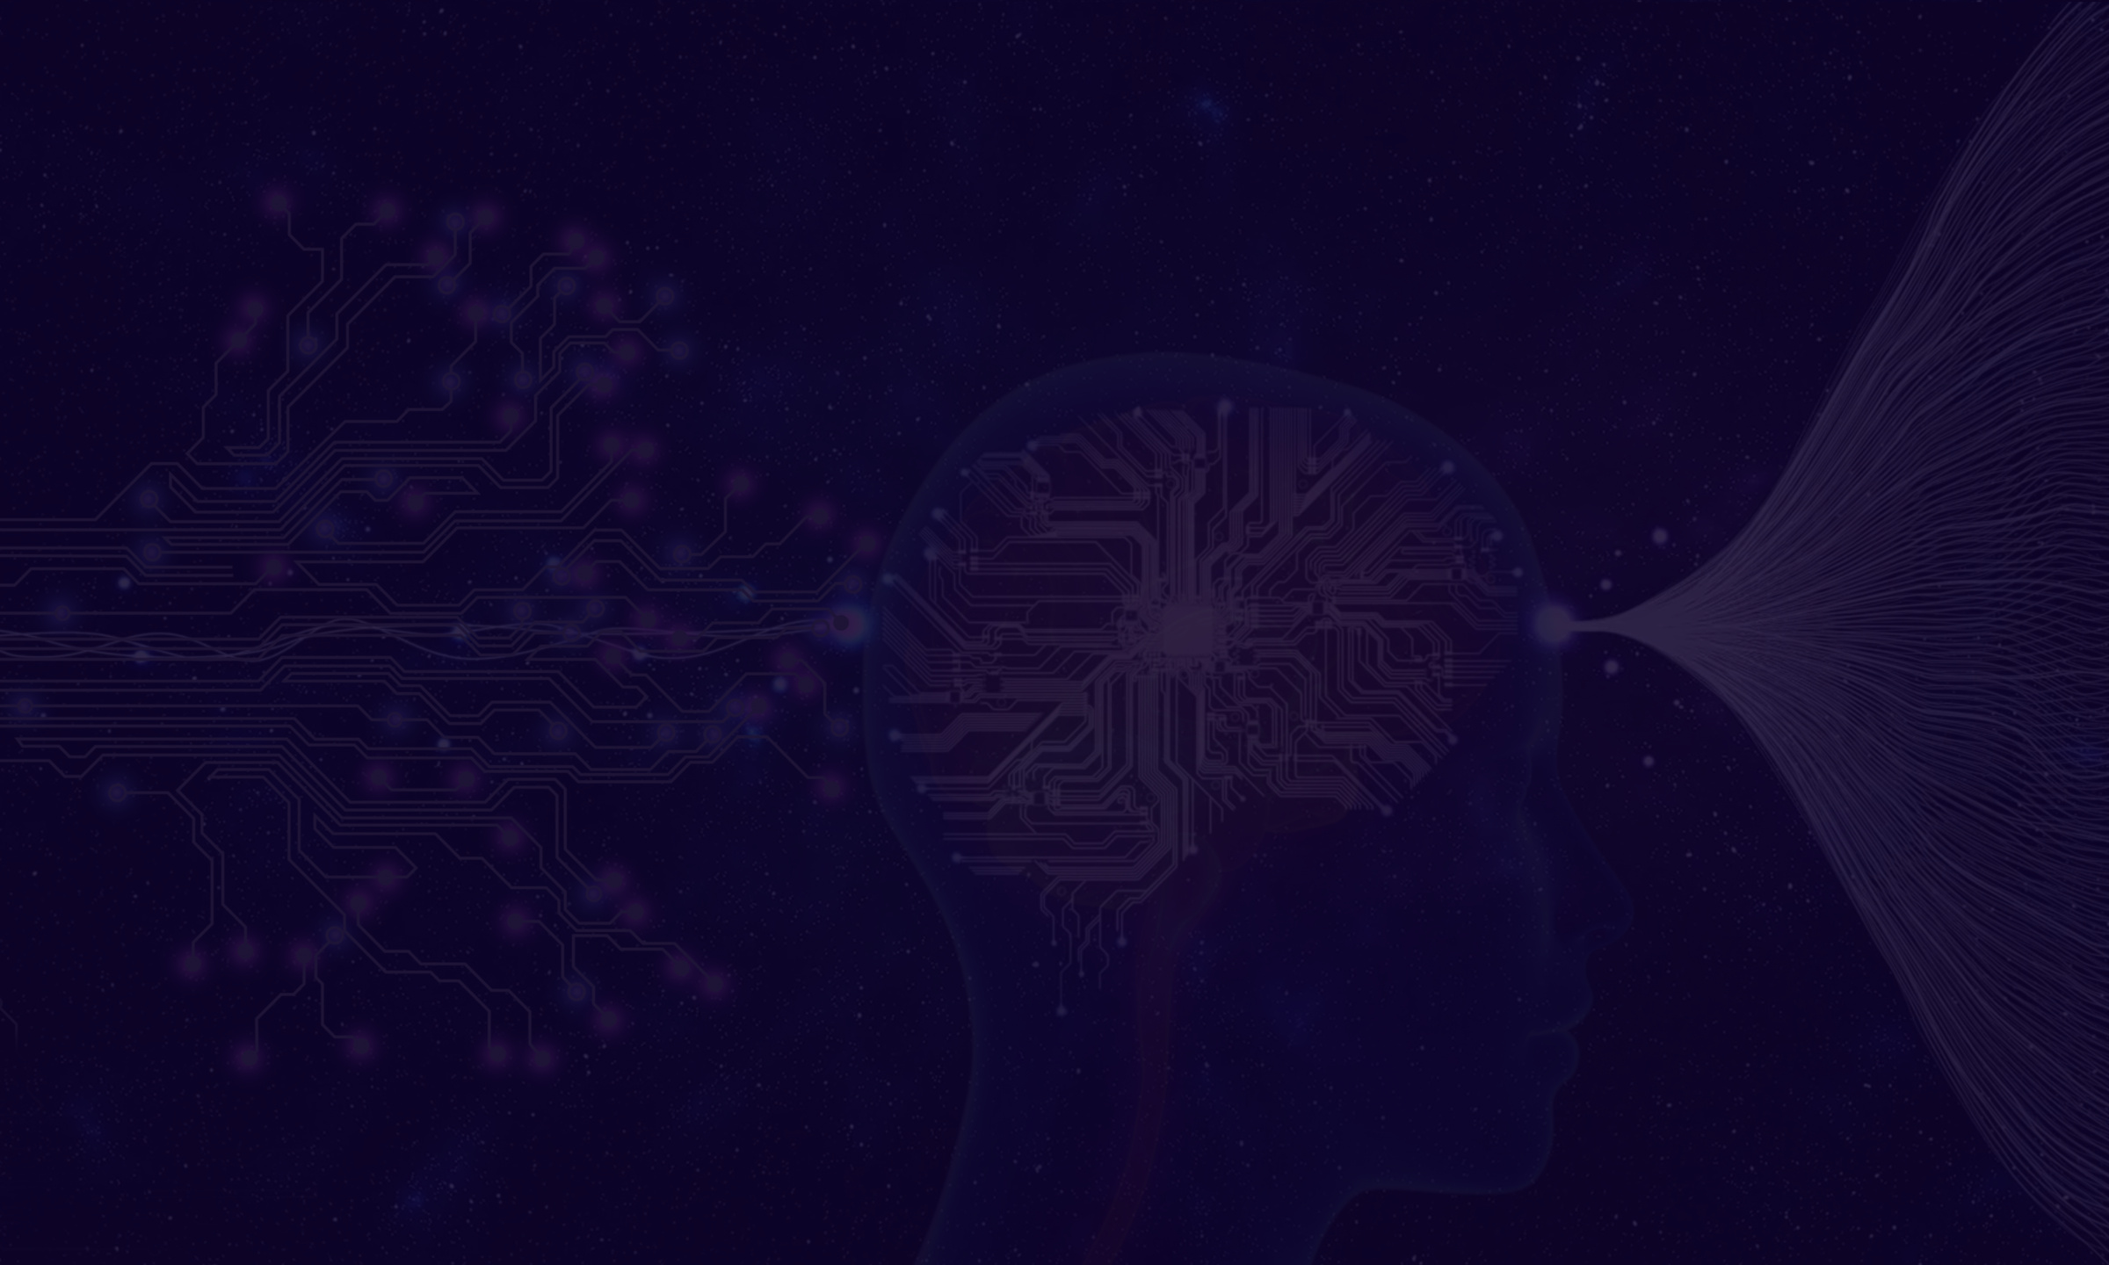
BUSINESS UNDERSTANDING
Client churn- loss of customers or over a specific period of time.
Fighting client churn has become a crucial concern in the dynamic telecommunications sector, as customers have many options for service providers and frequently switch carriers.
Understanding and reducing client churn is essential :
High churn rates can indicate customer dissatisfaction and potentially harm the company's brand image.
Churn directly translates to lost recurring revenue. Retaining existing clients is generally cheaper than acquiring new ones.
To Combat Client Churn: Companies can introduce
Loyalty Programs
Personalized Offers
Improved Customer Service

Slide 3

PROBLEM STATEMENT
SyriaTel, a telecommunications company, has experienced a significant rise in customer churn rates within the US market during the past financial period. This churn is leading to customer loss and negatively impacting SyriaTel's revenue. To address this challenge,I aim to develop a machine learning model that will help SyriaTel company's stakeholders to identify customers at risk of churn in the US.Additionally,this model will be used to develop targeted customer retention strategies and mitigate churn.

Slide 4
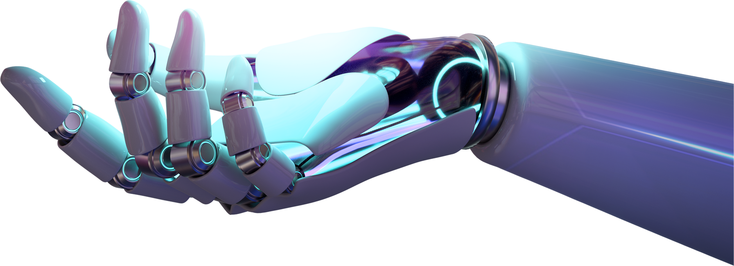
OBJECTIVES
MAIN OBJECTIVE.
To develop a machine learning classification model that accurately predicts customer churn in the US market for SyriaTel, enabling them to identify customers at high risk of churning and implement targeted customer retention strategies.
SPECIFIC OBJECTIVES.
To identify the key factors that contribute to customer churn in Syria Tel.
To develop a model that will accurately predict the probability of churn for individual customers in the US market.
To determine the likely solution to lower churn

Slide 5

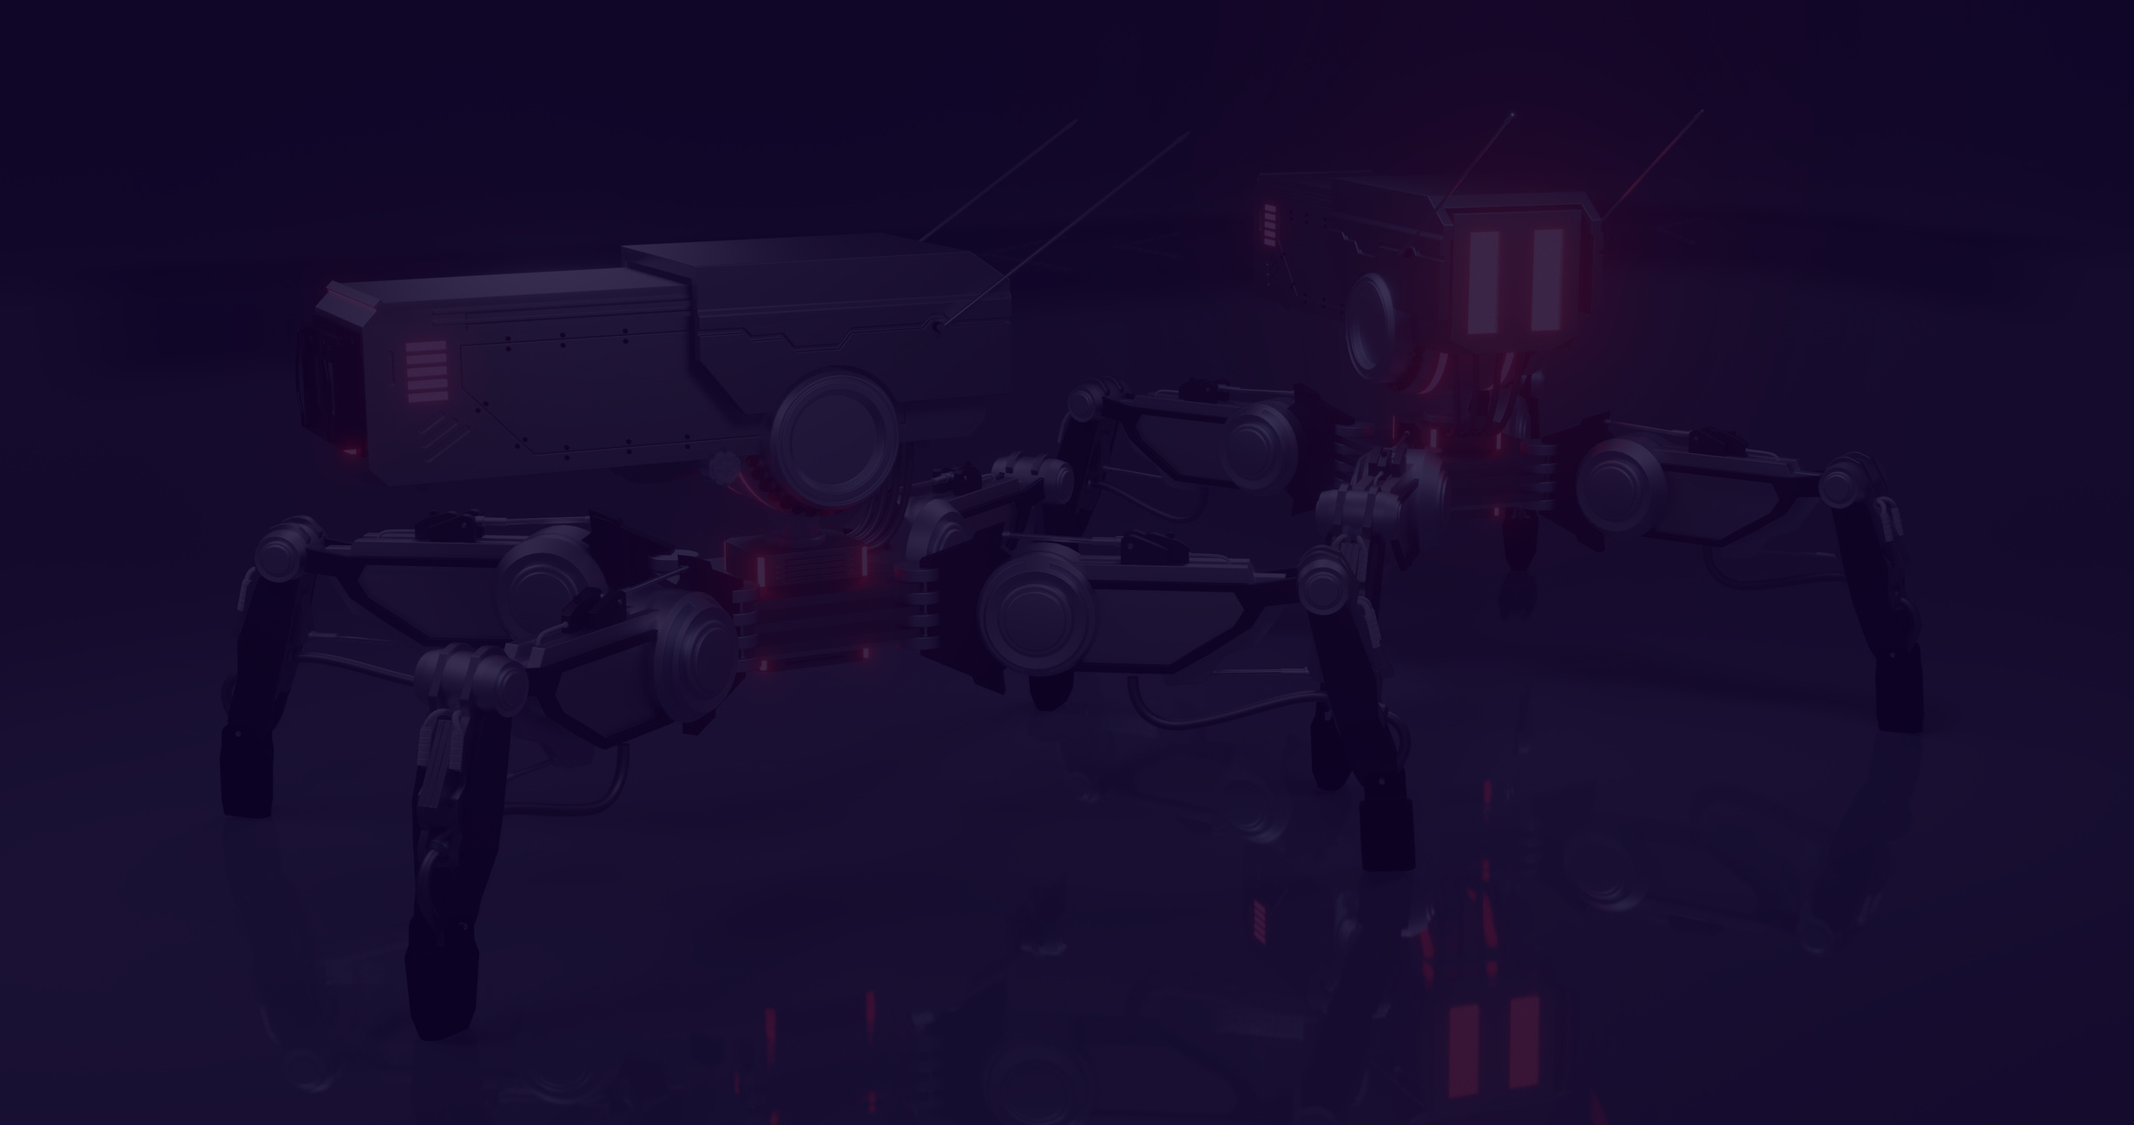
DATA UNDERSTANDING
The dataset contains various features details such as:
The customer's state
Account length
Area code
Whether or not the customer churned (terminated their contract).
Just to name a few
Summary of Features in the Dataset
state: the state the customer lives in - different states in America
account length: the number of days since the customer possessed an account
area code: the area code of the customer
phone number: the phone number of the customer
international plan: true if the customer has the international plan, otherwise false
The data set is made up of 21 columns
Data Source,kaggle website: https://www.kaggle.com/datasets/becksddf/churn-in-telecoms-dataset

Slide 6

DATA CLEANING AND PREPARATION
Data was clean
Removed hyphen from phone numbers
Droped the area code
Had no missing values
converted the numbers to integers
No much influence on our data set since we had the state column which equally showed geaographical area

Slide 7
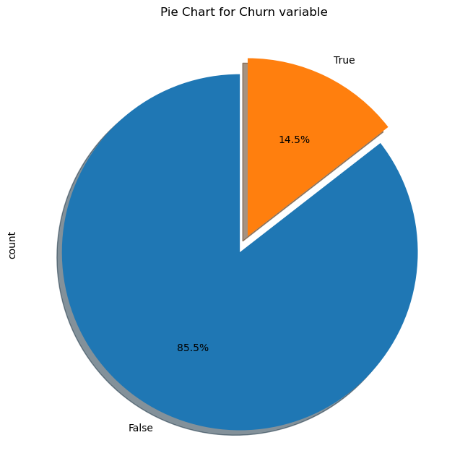
DATA ANALYSIS
The number of customers that did not churn was high compared to those that did churn
Out of the total number of customers 85.5% did not churn while 14.4% churned

Slide 8
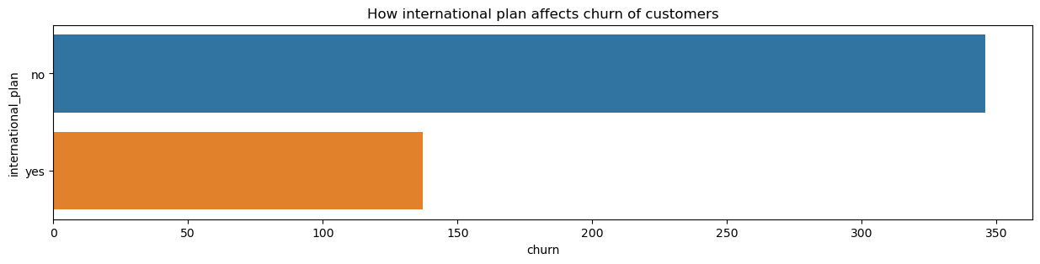
DATA ANALYSIS
The number of customers that syriatel was lossing and had international plan are (137) lower as compared to the customers that did not haThe number of customers that syriatel was lossing and had international plan are (137) lower as compared to the customers that did not have an international plan(346).
Majority of the customers or subscribers that Syriatel was lossing did not have international plan.

Slide 9
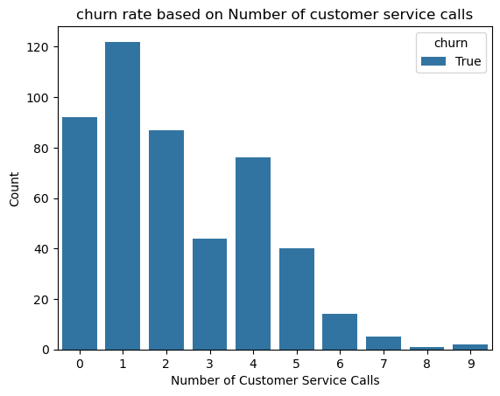
DATA ANALYSIS
Your pa
The rate of loss of customers /subscribers in syriatel was higher for the people who only made one customer service call followed by the customers who did not even bother making even a single call.
Customers who had be used to making upto 9 customer calls had a lower rate of churn.

Slide 10



MODELING
I modeled my data using the listed models
Your paragraph text
Random Forest with Pipeline and Gridsearch
Baseline model
Decision trees
XGBoost
Accuracy: 0.98
Recall: 0.872
Accuracy: 0.98
Recall: 0.864
Accuracy: 0.96
Recall: 0.832

Slide 11


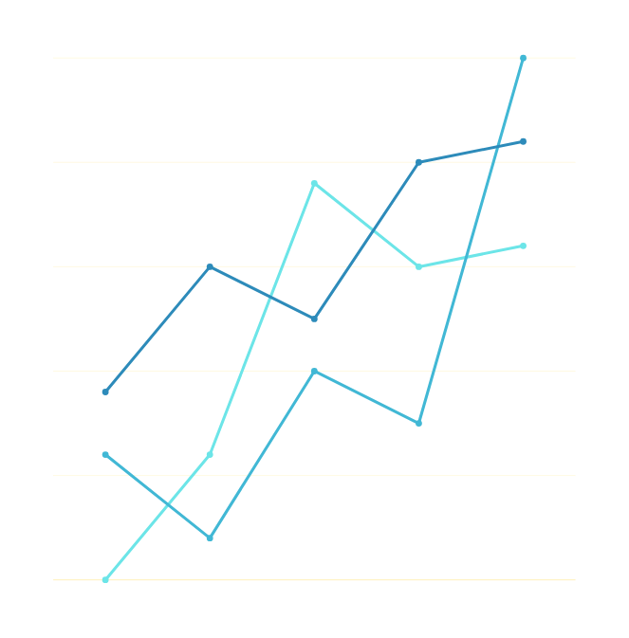
EVALUATION
'Churn' is the positive class and 'Did not churn' is the negative class. Reducing false negatives means concentrating on accurately identifying customers who are likely to churn (positive class).
To develop more effective tactics to minimize and reduce customer loss. As a result, I have decided to rank the models according to Recall/Sensitivity.
My baseline model stood out
Accuracy: 0.98
Recall: 0.872

Slide 12


CONCLUSION
The main objective and specific objectives were all satisfied.
The best model that modeled our data and gave us the desired results was DecisionTreeClassifier.
Features that highly contributed to loss of subscribers from Syriatel company were:
Total charges,
a customer having an international plan
customer service calls
I also noted we had a higher customer rate churn in NewJersey and California state.
Additionally,voice mail plan may not be highly desired by customers.

Slide 13
RECOMMENDATIONS
I would recommend Syriatel Company stakeholders to:
Check on how they charge their customers and reduce the total charges.
Look into their international plan,get to know what they are doing wrong, to be able to mitigate customers from leaving and looking for alternative international plans.
Retrain the personnel that handles the customer service desks on how to handle and address customer's complaints and how to effectively listen and be good to the customers.
Redefine how the company does its operations in Newjersey and California,since they were the state that had the highest customer churn rate and know what competitive service providers are doing to retain their subscribers.

Slide 14
NEXT STEPS
Testing the model on larger customer datasets to determine if they hold true across a wider customer sample will probably be necessary in order to enhance the models.
2. Possibly test models using datasets from rival cellular companies to see whether they are comparable.

Slide 15




Thank You!
kevin.muchori@student.moringaschool.com

